Slide 1
EDA & Business Intelligence Project
Dataset: Superstore Sales Dataset
Presented by: Shivasri

Slide 2
Key Metrics (KPIs)
Key Performance Indicators (KPIs)
• Total Orders: 9994
• Total Sales: High overall revenue observed
• Total Profit: Positive overall with some losses
Summary:
The dataset contains sales transactions across different categories, regions, and customers.

Slide 3
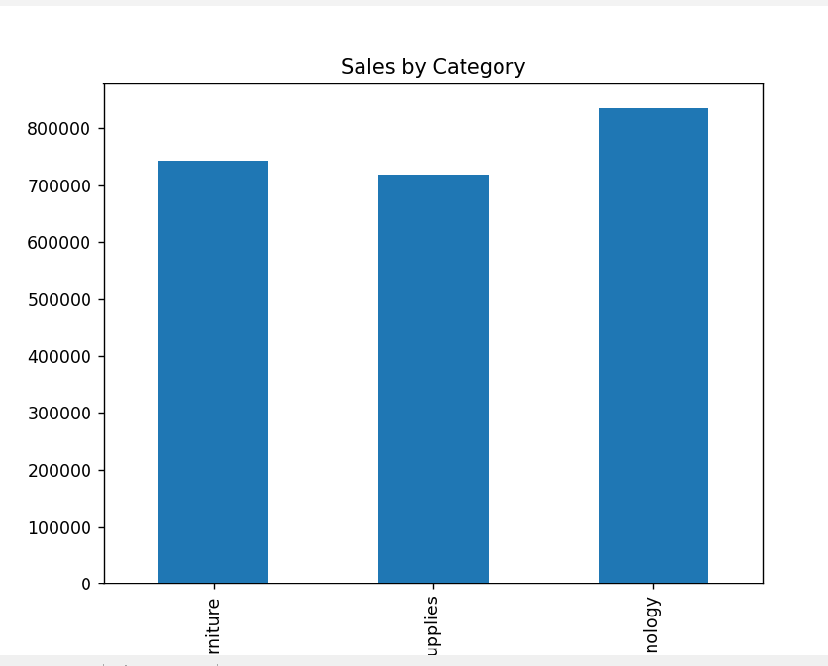
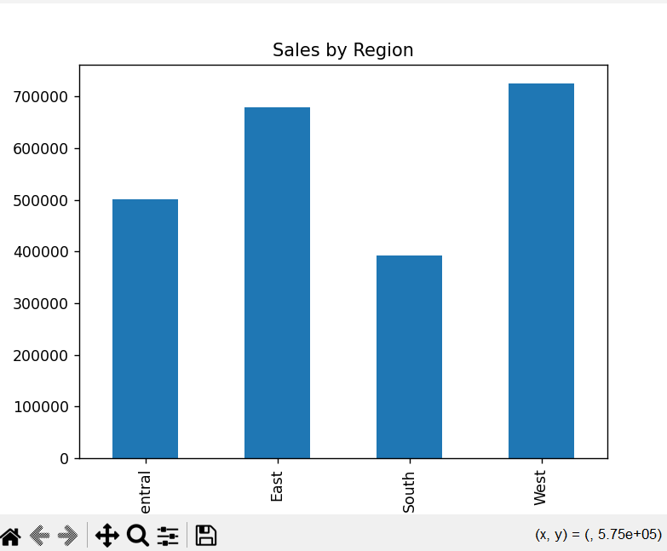
Visual Analysis

Slide 4
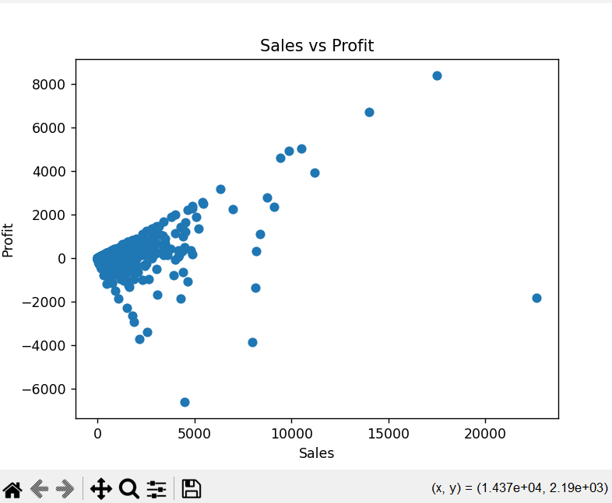
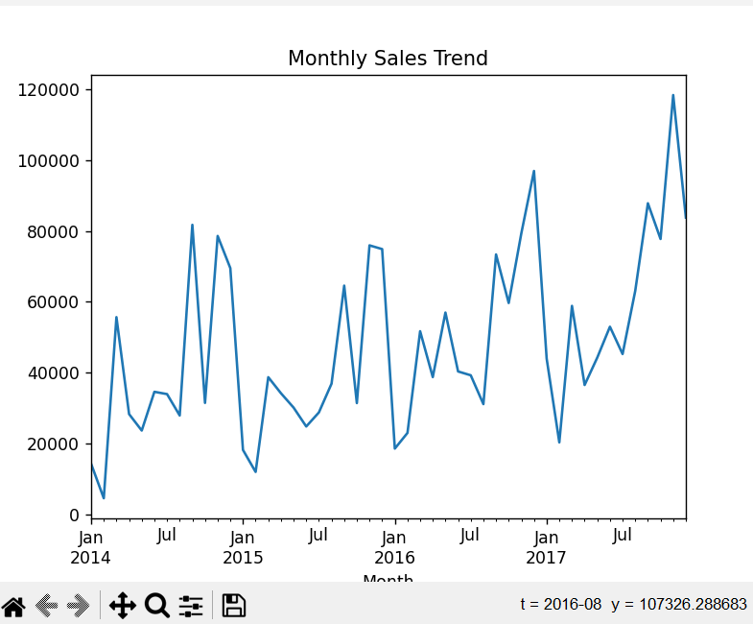

Slide 5
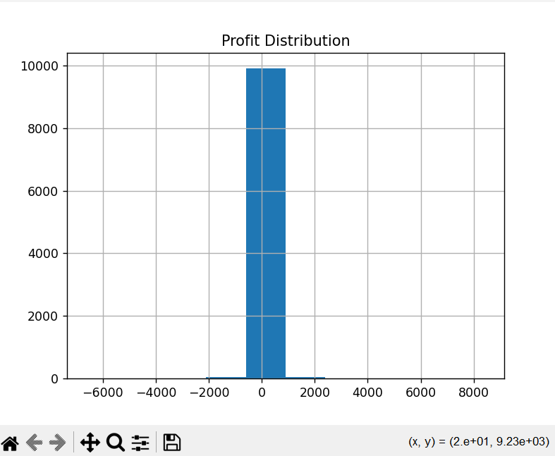
Visual Analysis
• Technology category shows highest sales
• West region generates highest revenue
• Sales vary across categories and regions

Slide 6
Key Insights
Key Business Insights:
• Technology category contributes the most to total sales
• West region performs better compared to other regions
• Some transactions result in negative profit (loss)
• Higher sales do not always guarantee higher profit
• Sales show variation over time indicating possible seasonal trends

